Slide 1
Digital Dog-Whistle Disinter
Bringing hateful online language to light
Author: Kaleb Robinson

Slide 2
What is a Digital Dog-Whistle?
Dog-whistles are coded hateful language
“Digital” dog-whistles, appear online
Are used in extremist groups to communicate in secret
Are linked to the spread of fascism, racism, homophobia, etc.
Dog whistles are good for indoctrination
They hide hate speech

Slide 3
Vision for the Project
To bring to light the usage of dog whistles online
Inform the public why it is problematic
Act as a sort of “PSA”
Prevent indoctrination
Expose online dog-whistles

Slide 4
Why “Disinter” and not “Detector”
Disinter means to un-Earth or bring to light
My project doesn’t “Detect” anything
It finds these words and shows them
Not perfect, but I like the term
The word Disinter starts with a D, more catchy!

Slide 5
How does the Digital Dog-Whistle Disinter Work?
Uses a “corpus” to get a list of most used words
Generated from Reuters online news
Uses this list to generalize the appearance of words in normal speech
Scrapes text data from an online source, creates list
Compares the two lists, displays them graphically

Slide 6
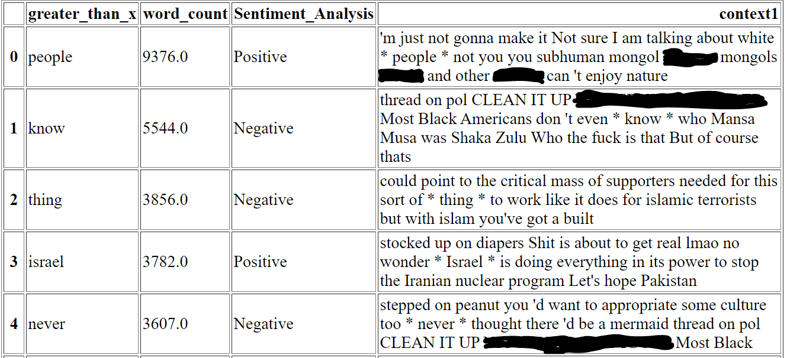
Limitations of the System
Reuters is a business source
Takes form one source not many
NLTK sentiment analysis is positive and negative
Different sites uses different lingo
Doesn’t capture atypical words

Slide 7
Testing
End to End test
Unit test
End to End testing revealed a couple of bugs
Unit testing helped to explain them

Slide 8
Lessons Learned
Word processing can take a long time
Dog-whistles are hard to distinguish
HTML experience
Web scraping can be a delicate process
Error handling is important

Slide 9
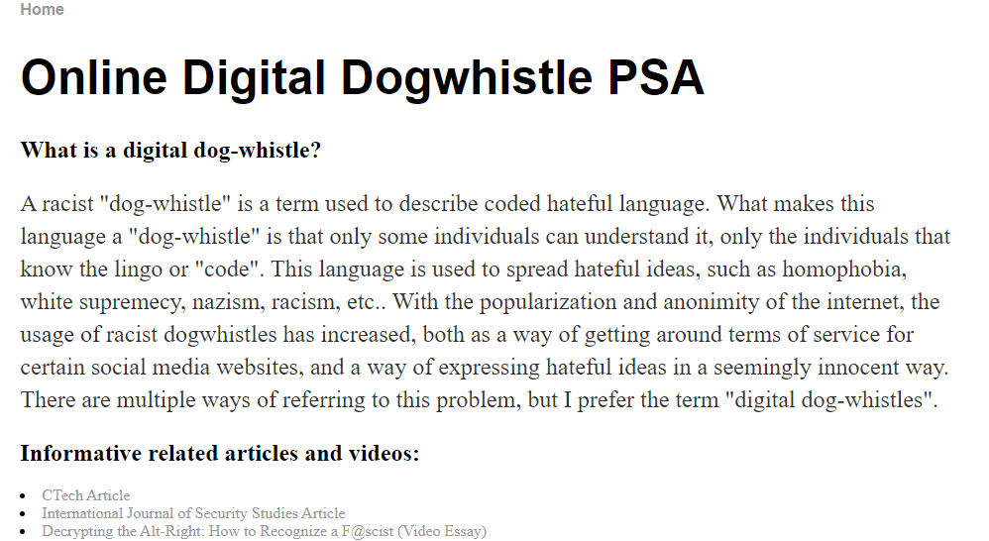
The Website
Anyone can access it
Acts as a sort of PSA
Explains the issue
Links to outside sources
Features the Digital Dog-whistle Disinter
https://robinsonkal.github.io/

Slide 10
Questions?
https://robinsonkal.github.io/

